Slide 1

yarnnn
Your autonomous AI agent — powered by accumulated work context
It connects to your tools. It learns your world. It works while you don't.
(Pre) Seed Round 2026
Kevin Kim · kvkthecreator@gmail.com

Slide 2
It looks like the big players will own everything.
Claude has coding agents, desktop, cowork.
ChatGPT has memory, Codex, Sora.
The market assumes they’ll consume every layer.
But every platform cycle looks that way — until it doesn’t.
Google didn’t become Salesforce.
Facebook didn’t become Shopify.
AWS didn’t become Datadog.

Slide 3
The Honest Bet
History never repeats, but it does rhyme.
Our thesis is that even with the AI tech revolution, the application layer is yet to come.
2008: Google
→ Looked like it would own everything on the web. It didn’t become Salesforce.
2012: Facebook
→ Looked like it would own all of social commerce. It didn’t become Shopify.
2015: AWS
→ Looked like it would own every cloud application. It didn’t become Datadog.
2026: LLMs
→ Look like they’ll own every layer. But code was the easy case. Work context is the hard one.
The application layer of the AI platform shift is yet to come, and we’re taking the bold bet that it will be Agent-native, and the work economy will shift from human -> agents

Slide 4
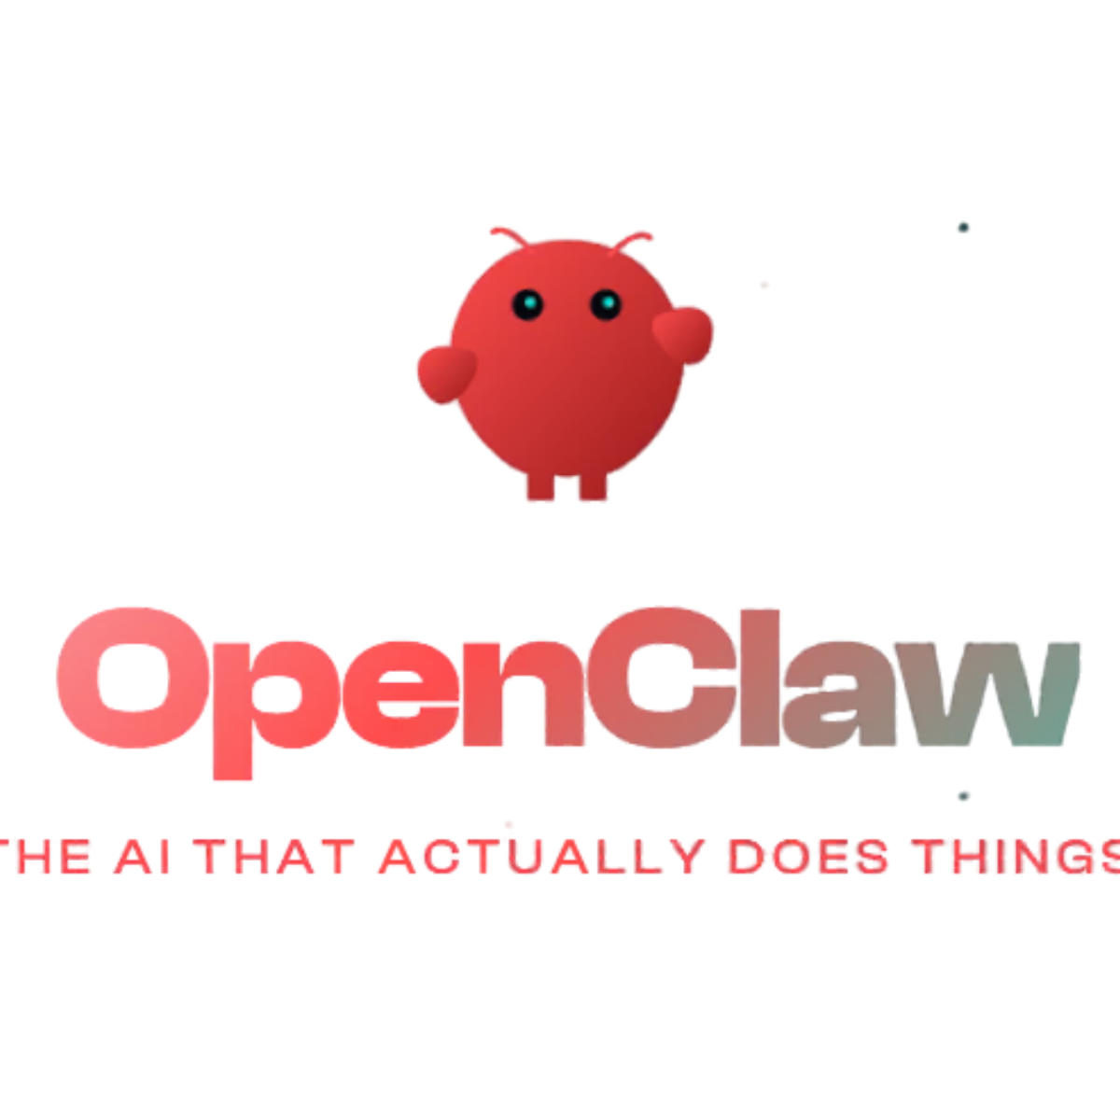
Proof of Demand
ClawdBot proved the appetite is real.
17,830
But 95% of people can't use it.
GitHub stars in 24 hours
High technical barrier, privacy, hardware setup
Fastest single-day growth in GitHub history.
"The first time I've felt like I'm living in the future since ChatGPT launched."
✘ Requires VPS provisioning (only 5% can do this)
✘ 200+ security leaks detected (GitGuardian)
— ClawdBot user
✘ No project isolation or recurring workflows

Slide 5
Product
Architecture
Solution / Moat

Slide 6
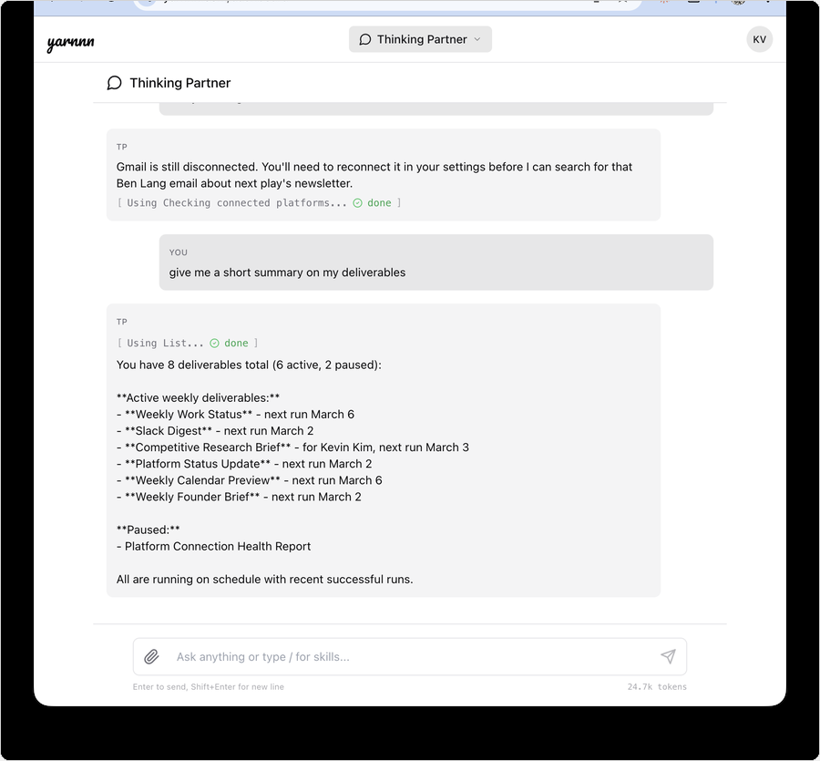
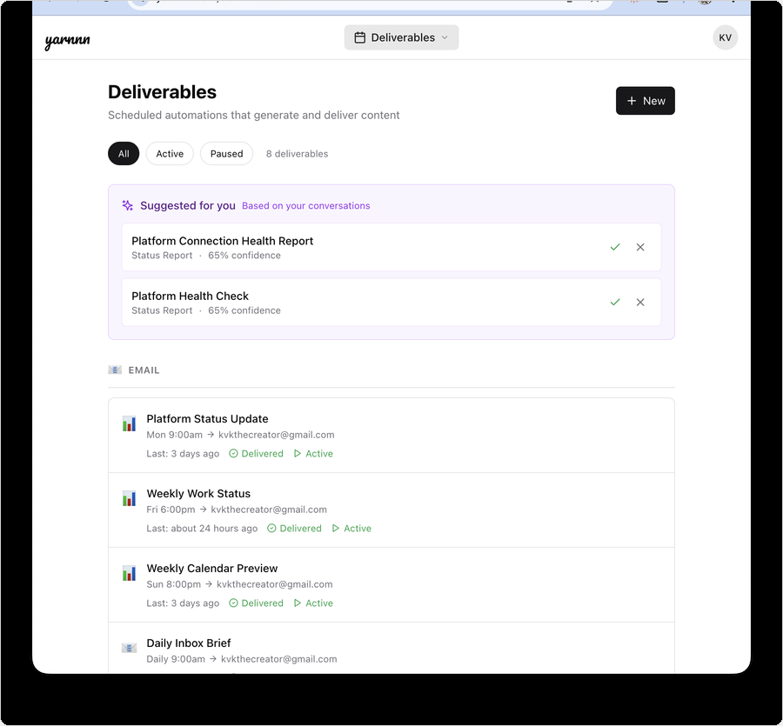
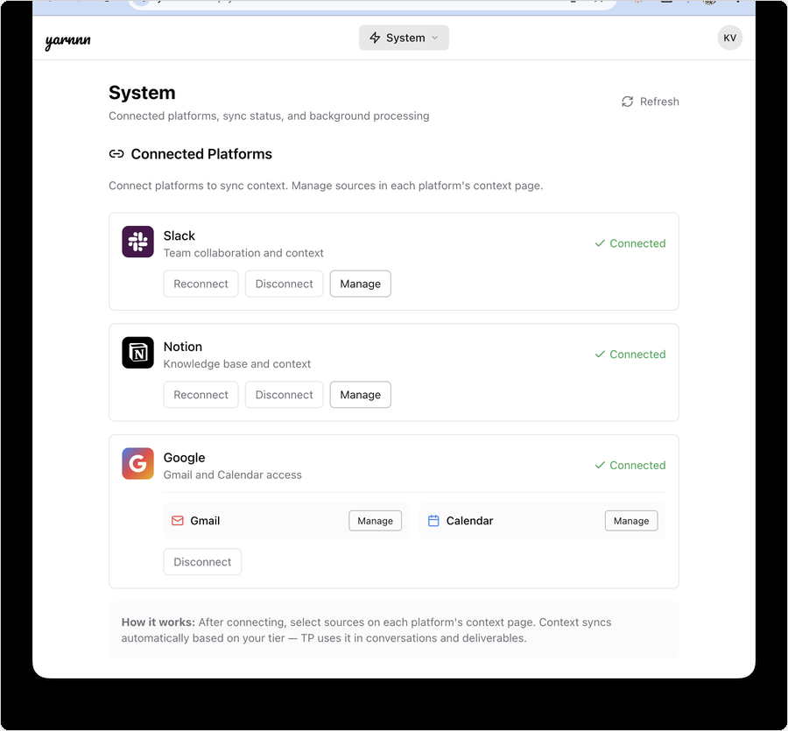
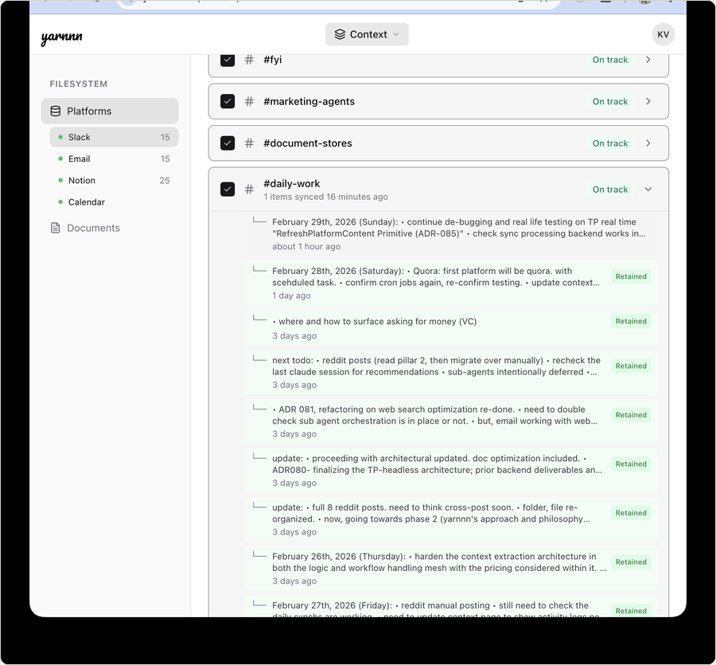
Product: meet yarnnn’s agent: Thinking Partner TP
Your autonomous AI agent. Live at yarnnn.com.
01
Chat Mode
02
Headless Mode
03
3 Platforms + MCP
04
Context Engine
Ask anything. TP already has the context. Built like Claude Code with primitive tools, webSearch
Autonomous tasks on schedule. Mechanical scheduler, task pipeline, compose substrate
Slack, Notion, GitHub.
MCP hub connects any LLM to your context
Accumulated workspace intelligence.
Context domains, filesystem-as-memory, inference

Slide 7
Agent Architecture and Orchestration
Built for Agent-native, autonomous workflows
Designed so context compounds over time, creating recursive feedback between outputs and agent architecture
Platforms
Slack • Notion • GitHub + MCP Context Hub
Context Domains
Workspace filesystem Accumulated intelligence
Memory
Inference engine Memory + feedback
Agent Workforce
10-agent roster Task pipeline + compose
Delivery
Email, HTML, PDF Usage-metered
→
→
→
→
Why this can’t be bolted on:
Big Players, LLM Providers
Agent Startups
Workspace AI
No persistent cross-platform context layer.
Session-based. No accumulated workspace intelligence.
No workspace filesystem or identity layer.
Task execution only, no context accumulation.
No feedback loop or developmental trajectory
Single-platform. Can’t synthesize across tools.
No autonomous output or cross-LLM continuity.
Every layer purpose-built for context accumulation, autonomous work + cross-LLM intelligence

Slide 8
Solution: Compounding Stickiness
Value Compounds with Every Execution Cycle.
Connect your platforms. TP learns your world. Tasks run on their own.
DAY 1
DAY 30
DAY 90
Connect + Context
Autonomous Output
Irreplaceable Intelligence
Link Slack, Notion, GitHub. Inference maps your world in minutes. TP already knows your work.
Scheduled tasks run without prompting. Each one learns from your edits and feedback.
90 days of accumulated context. TP knows your clients, your projects, your style. No generic tool can replicate this.
WHAT YOU GET:
WHAT RUNS ON ITS OWN:
WHAT ONLY YOU HAVE:
• Ask TP anything — shared context is key
• Pre-meeting brief from Slack + Notion • Project status from channel activity
• Weekly client updates from project channels • Monday meeting prep with attendee context • Monthly board report from accumulated context
• Deal alerts when pricing surfaces in Slack • Cross-platform research digests • Switching cost: context is irreplaceable

Slide 9
Solution: Moat
Switching Costs compound as Context Accumulates
Every interaction makes yarnnn harder to replace and more valuable to keep.
Platforms (Slack, Notion, GitHub + MCP)
Connect
Accumulate
Automate
Supervise
Why This Creates a Moat:
1
Accumulation: Every task run deepens cross-platform understanding
2
Recursion: Your edits teach the system — output quality compounds
Compounding Work Intelligence
3
Switching costs: 90 days of context is irreplaceable by any competitor
4
Cross-LLM hub: MCP makes every LLM a client of your accumulated context
Edits, refine
memory
Context syncs
Autonomous Agent System

Slide 10
Proactive Intelligence
Your AI works while you don't.
Mechanical scheduling + transparent token-spend metering. Every LLM call tracked in USD.
Layer 1: Scheduler
Scheduler triggers task pipeline
Zero LLM cost at scheduling layer
SQL-driven cron, pure mechanical
Layer 2: Task Pipeline
Sonnet generates from accumulated context
Cost: ~$0.05 per task run
Compose substrate assembles structured output
Layer 3: TP Orchestration
Single intelligence layer for all judgment
Chat + task evaluation + steering
Every token metered transparently in USD
2x markup on Anthropic API rates. ~50% platform margin. Users see exactly what they spend.

Slide 11
Positioning • Market •
Competitive Landscape

Slide 12
Positioning
Not another chatbot. Not another agent framework.
The only agent that accumulates cross-platform work context and uses it for autonomous output.
Autonomy
yarnnn
Big-Players
ChatGPT/Claude
Agent Startups
Mem.ai, Genspark
Workspaces Notion, Slack
Cross-platform context accumulation
✓ Evolving
✘
✘
Single
ChatGPT
yarnnn
Claude / Genspark
Cross-platform sync
✓
✘
✘
✘
Cross-Context
Accumulation
Autonomous output
✓ Scheduled
✘
✓
✘
Improves with tenure
✓ Accumulation
Evolving
✘
✘
Existing
Workspaces
Agent-based
Startups
Context-aware agent
✓
Evolving
✘
Basic

Slide 13
Market
Starting with solo consultants. Expanding from there.
Entry wedge: Solo consultants with recurring client obligations
TAM
SAM
Entry SOM
$4.35B
$1.14B
$11.4M
AI productivity tools market (31% CAGR)
~5M solo consultants globally × $228/yr (Pro annual)
50K consultants (1% SAM) in first 3 years
Expansion path:
Now
Solo consultants
Recurring reports, clear pain, willing to pay
Next
Founders & executives
Investor updates, board prep, strategic briefs
Then
Teams & ops leads
Standups, project reports, cross-team synthesis
Scale
All knowledge workers
Any professional with recurring work obligations

Slide 14
Pricing Model
Usage-first billing. Balance is the single gate.
Free
Top-Up
Pro
$0
/mo
$10+
one-time
$19
/mo
• $3 signup balance included
• One-time: $10, $25, or $50
• $20/mo balance auto-refills
• All platforms + tasks unlocked
• Add balance when you need it
• All platforms + tasks unlocked
• ~40 chat turns + 10 task runs
• No commitment or subscription
• Meaningful autonomous workload
• Token spend metered in USD
• Same features as subscription
• $19/mo or $180/yr
• Hard stop when balance hits $0
• Primary upgrade path
• Best value for regular users
Unit economics: 2x markup on Anthropic API rates = ~50% gross margin. No operational limits. Balance is the single gate.
Every LLM call metered transparently in USD. Users see exactly what they spend.

Slide 15
(Pre) Seed - The Ask
$500K–$1M seed round at $5–10M valuation.
Use of funds:
Why now:
Positioning:
→ Tech Lead (memory/ML)
→ ClawdBot: 17,830 stars / 24hrs
→ Application layer sill pre-mature
→ GTM Lead (creator community)
→ No one owns the context layer
→ True Agent-native architecture
→ 12–18 months runway
→ Architecture built, need team
Priority 0: Team-Building
Betting on an agent-first future:
Differentiation:
→ ML engineer for memory extraction
→ LLM readiness moving towards Agents
→ Cross-platform, LLM agnostic
→ Community builder for creator GTM
→ Thesis is the work economy will shift
→ Big players can’t do cross data accumulations
→ Seed funds → team of 3

Slide 16

yarnnn.com · Kevin Kim · kvkthecreator@gmail.com

Slide 17
Appendix
Kevin Kim
Founder & CEO, KVK Labs (yarnnn)
https://www.linkedin.com/in/kimseulki0727/
B.S. Industrial and Systems Engineering, Virginia Tech
+10 years designing CRM and GTM systems in FMCG.
Full-stack application for yarnnn, (Next.js + FastAPI + Supabase), three platform integrations + MCP hub, unified agent architecture documented across 170+ Architecture Decision Records.
Aiming to target US market, and execute GTM and team-building as priority next step.
kvkthecreator@gmail.com · yarnnn.com

Slide 18
Appendix
Shipping velocity is the moat at pre-seed.
MVP live at yarnnn.com. Solo build, 14 weeks from first commit to production.
Every metric below is from real usage, not projections.
SIGNAL 1:
SIGNAL 2:
SIGNAL 3:
Iteration Speed
Real Intelligence
Platform Depth
13 task types in registry
12+ prompt iterations per type
7 pipeline bugs caught and fixed in testing
Proactive review filters signal from noise
$0.002 review / $0.05 generation per cycle
Generates only when context warrants it
Slack, Notion, GitHub + MCP — all live
Paginated sync with delta detection
Retention-based accumulation: context compounds
EVIDENCE:
EVIDENCE:
EVIDENCE:
Commit-to-fix cycle: hours, not weeks
Review pass correctly identifies 'nothing new' vs 'act now'
First useful answer under 60 seconds from signup
Pre-revenue by design. Building the intelligence layer before the growth layer.

